Slide 1
Welcome to Mini Summit 2
Instructions for first 10 Minutes (8:30-8:40)
Sit in your project group area
Introduce yourselves to new members
Discuss what you want to share about your group’s aspiration statement – you will have no more than two minutes.
Move to the center of the room at 8:40

Slide 2

Stakeholder Mini Summit Session 2: Develop Goals and Objectives
June 1, 2018

Slide 3
Objectives for Today’s Sessions
Provide an update on strategic planning process
Refine aspiration statements for each strategic initiative
Identify the links to areas of strategic focus
Develop specific objectives for each area of strategic focus
Begin developing lists of actionable ideas for each strategic initiative

Slide 4
Agenda
Welcome: Dr. Cheryl Schrader
Introduction: Dr. Susan Edwards
Overview: Dr. David Bright
Plenary: Aspirations
Groups: Working sessions
Wrap-up: Final Reflections

Slide 5
Welcome from Dr. Schrader

Slide 6
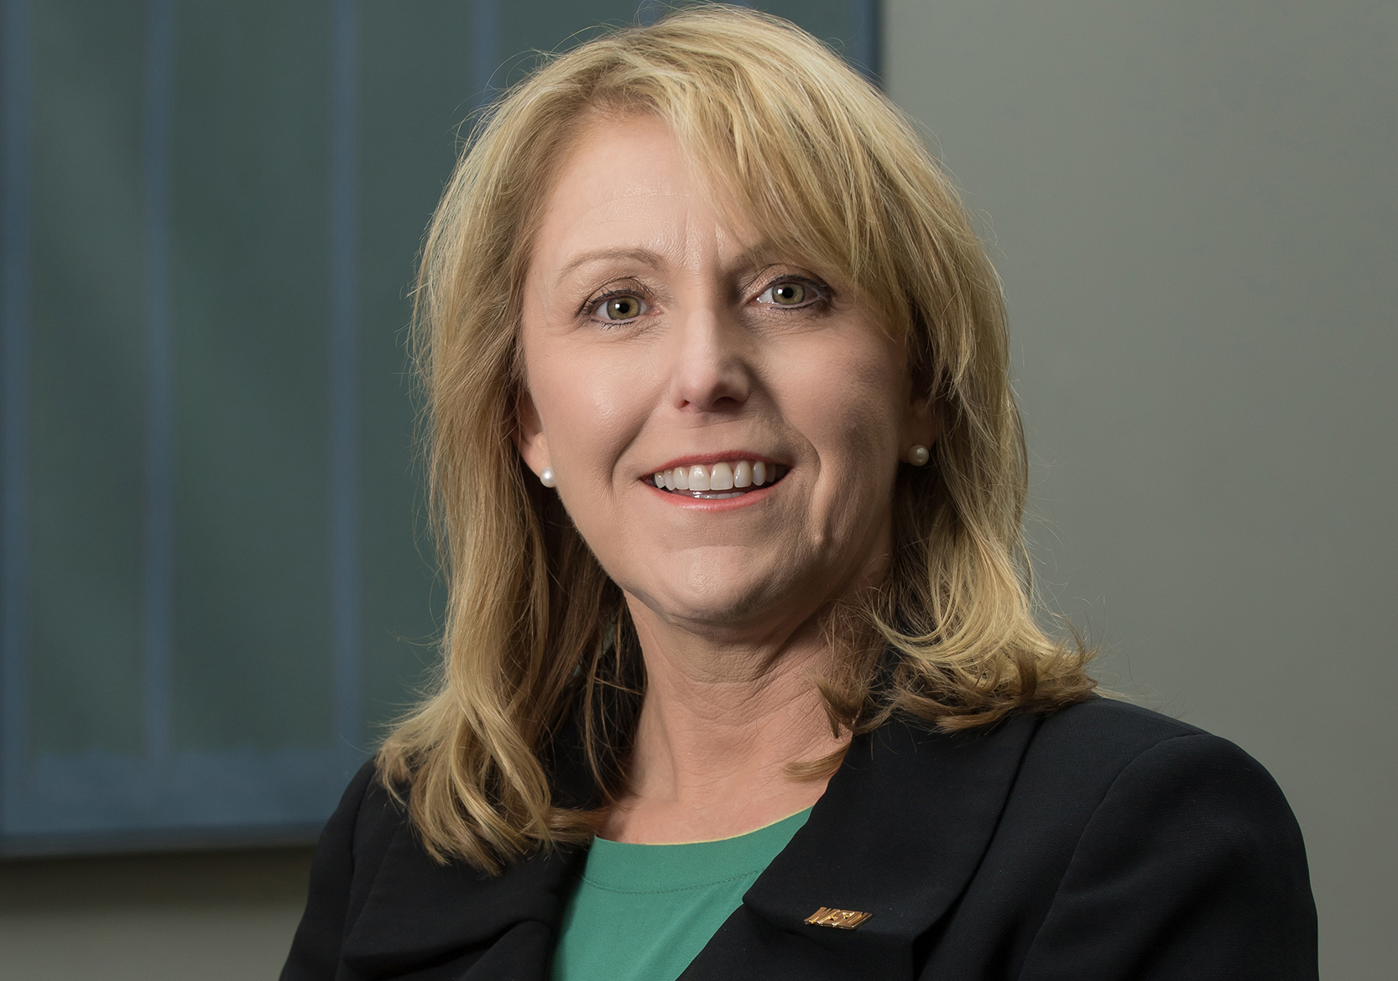
Introducing Dr. Susan Edwards

Slide 7
Elements of our Strategic Plan
Vision/Mission/ Values
Strategy
Statement
Milestones
Areas of
Strategic Focus
Actions and Initiatives
Strengths and Opportunities
Indicators and Metrics
Conditions of Success
Resources
Stakeholder Descriptions
Together, we will build the
areas highlighted In red.
Phase 1
Phase 2

Slide 8
Phase 1: Engagement around Vision, Mission, Values
Develop Initial Understanding of Stakeholder Perspectives
Use Inclusive Process to Prioritize Key Ideas
Organize Steering Committee
Develop Revised
Statements
Test and Revise
Share the Vision
Community
Dialogue
and Surveys
Stakeholder
Committee Drafts
Solicit Stakeholder Feedback
Culminating
Event
Kick-Off Event
Summit
VMV
Planning
Overview
Initial Lists of
VMV Themes
and Strategic Ideas
Prioritized VMV Themes and Strategic Ideas
Initial
VMV Statements
Tested
VMV
Statements
Finalized VMV Statements
Capture Strategic Ideas as They Surface
PHASE 2:
STRATEGY
DEVELOPMENT
January
February
March
April

Slide 9
Phase 1 Milestones
10 Community Dialogue Sessions (320+ participants)
3-Day Summit (120+ participants)
Session 1: Values, Mission, and Vision
Session 2: Strengths
Session 3: Opportunities
Session 4: Aspirations
Drafting of Statements
Values, Mission, Vision, Areas of Strategic Focus
Strategic Planning Open House

Slide 10
Proposed Statements
Values that Shape our Mission
Foster Student Success
Discover, Create and Share New Knowledge
Transform our World
Values that Define our Character
Principled
Visionary
Innovative
Collaborative
Inclusive

Slide 11
Proposed Statements
Mission
Wright State University empowers all students and graduates to realize their fullest potential as innovative leaders and global citizens by integrating research, learning, and transformational experience
Vision
Inspired by the spirit of the Wright brothers, Wright State University will be a leading national public research university known for innovation and application; respected for an inclusive culture; and recognized as an essential part of the economic, cultural, and educational fabric of the communities we serve.

Slide 12
Areas of Strategic Focus
Strategic Initiatives
Strategic Initiatives
Technology, entrepreneurship
and innovation
Research, Innovation, and Entrepreneurship
Community & Military Partnerships
Research and
Scholarly Activities
Alumni and Advancement
Strategic Relationships/
Partnerships
Student Academic
Support and Services
Globalization and
International Outreach
Teaching, Learning, and Programming
Student life
Experiential Learning
Inter-Unit Collaboration
The Wright State Experience
Curriculum Development &
Course Design
Faculty and Staff Development
Online Courses
Collaborative Delivery of Services
Digital Transformation of Services
Stewardship: Managing
Resources Effectively

Slide 13
Phase 2: Development of Strategic Plan
PHASE 1:
ENGAGEMENT (Vision, Mission, Values)
Use Inclusive Process to Develop Strategic Themes
Use Diverse Stakeholder Groups to Develop
Strategic Initiatives and Areas of Strategic Focus
Share the Vision
Full Stakeholder/
Project Group Meetings
Steering Committee
Meetings
Interim work by Project Groups and Steering Committee
Final Steering Committee
Meeting(s)
Presentation to
the Board of
Trustees
Stakeholder
Summit
Draft Actions and Initiatives
Draft Areas of Strategic Focus
Develop Goals and Objectives
for Areas of Strategic Focus
Develop Action Plans for
Strategic Initiatives
Develop a Map
for each Area of
Strategic Focus
Compile an integrated
strategic plan
Finalized Strategy Document
Create
Project Groups
for Focused Work
Draft
Strategy
Statement
Refined
Strategy
Statement
March
April
May
June-August
August-September
October

Slide 14
Rounds of Summer Activity
Mini-Summit
Group Work
-----
Stakeholder Surveys
Leadership Meeting
(As needed)
Steering Committee Meeting
3-week cycle

Slide 15
Progression of Work
Round 1
Establish working groups and “the most important goal”
Round 2
Develop goals & objectives – continue work on initiatives
Round 3
Develop lists of actions for each initiative
Round 4
Evaluate & prioritize actions
Round 5
Round 6
Identify metrics, resources, milestones
Assemble the strategic plan
Public Event
Survey:
Mission-Focused
Values
Survey:
Character-Focused
Values
Survey:
Mission, Vision,
& Strategy Statement
Survey:
If needed

Slide 16
Key Design Assumptions
Project groups for each strategic initiative
Output shapes the overall university strategic plan
Mini-summits provide forum for group work
Minimal “homework” between sessions
Reliance on self-organizing around these roles
Coordinator
Core Member
Supporting Member

Slide 17
Role of Participants
Develop a Plan for a Strategic Initiative
Aspiration statement: Future impact of strategic actions
Objectives: How the initiative contributes to areas of strategic focus
Actions: Specific projects that will be included in the initiative
Milestones: Future moments of success for each initiative
Indicators and Metrics: How to track our progress
Resources and Support: Conditions required for success

Slide 18
Elements of our Strategic Plan
Vision/Mission/ Values
Strategy
Statement
Milestones
Areas of
Strategic Focus
Actions and Initiatives
Strengths and Opportunities
Indicators and Metrics
Conditions of Success
Resources
Stakeholder Descriptions
The 15 initiative groups will focus on these elements.
Phase 1
Phase 2

Slide 19
Elements of our Strategic Plan
Vision/Mission/ Values
Strategy
Statement
Milestones
Areas of
Strategic Focus
Actions and Initiatives
Strengths and Opportunities
Indicators and Metrics
Conditions of Success
Resources
Stakeholder Descriptions
The steering committee will focus on these elements and on integration.
Phase 1
Phase 2

Slide 20
Principles of Self Organizing
Vote with your feet!
Commit to work on the current tasks for a particular topic for a period of time that you clearly communicate to others.
Feel free to make a contribution to other topics.
Theme coordinators should remain with a single group.
Recruit others to join your efforts.
Anyone can participate and contribute as they are able.

Slide 21
Role of Participants: Develop a Plan for a Strategic Initiative
Element of Plan | Mini Summit Dates
1. Aspirations | May 18 and June 1
2. Objectives | June 1 and June 22
3. Actions | June 22 and July 13
4. Milestones | August 1 and August 31
5. Metrics | August 1 and August 31
6. Resources and Support | August 1 and August 31

Slide 22
Progress Reports: Steering Committee
Vision/Mission/ Values
Strategy
Statement
Milestones
Areas of
Strategic Focus
Actions and Initiatives
Strengths and Opportunities
Indicators and Metrics
Conditions of Success
Resources
Stakeholder Descriptions
The steering committee will focus on these elements and on integration.
Phase 1
Phase 2

Slide 23
A Strategy Statement
Objective = Ends
The single precise objective that will drive the organization for the next seven years; it is specific, measurable and time bound.
Scope = Domain
A description of the customer or offering, geographic location and level of vertical integration.
Advantage = Means
The customer value proposition and the unique activities that allow the organization alone to deliver it.
Source: Collis & Ruskad, 2008

Slide 24
Progress Report: Strategy Statement
Met with Dr. Schrader on May 21
Read through the proposed statements from May 18 Summit
Identified preliminary list of indicators for values
Clarified process for crafting the statement
Gather perspectives on indicators of value
First draft will be developed by Dr. Schrader and small group
University leaders will provide feedback
The broader community will provide feedback
Link to blog report

Slide 25
Progress Report: Mission-Focused Values Survey
Sent to the University community and stakeholders this week
Approximately 100 responses thus far.
Will be open until end of next week
Please complete it!
Link to the Mission-Focused Values Survey

Slide 26
Progress Report: Strategic Initiatives
Vision/Mission/ Values
Strategy
Statement
Milestones
Areas of
Strategic Focus
Actions and Initiatives
Strengths and Opportunities
Indicators and Metrics
Conditions of Success
Resources
Stakeholder Descriptions
The 15 initiative groups will focus on these elements.
Phase 1
Phase 2

Slide 27
Progress Report: Strategic Initiatives
Coordinators group has been organized
Group pages being created on web site
Most groups completed Homework 1
Task 1: Refine aspiration statements
Task 2: Identify potential inks to areas of strategic focus
Task 5: Recruit new members

Slide 28
Next Steps: Homework 2
Task 6: Welcome new members
Task 7: Draft objective statements
Task 8: Refine your aspiration statements
Task 9: Develop lists of potential actions

Slide 29
Strategic Initiatives
(Project Groups)
Areas of Strategic Focus
(Steering Committee)
Strategic Initiatives
(Project Groups)
Technology, entrepreneurship
and innovation
Research, Innovation, and Entrepreneurship
Community & Military Partnerships
Research and
Scholarly Activities
Alumni and Advancement
Strategic Relationships/
Partnerships
Student Academic
Support and Services
Globalization and
International Outreach
Teaching, Learning, and Programming
Student life
Experiential Learning
Inter-Unit Collaboration
The Wright State Experience
Curriculum Development &
Course Design
Faculty and Staff Development
Online Courses
Collaborative Delivery of Services
Digital Transformation of Services
Stewardship: Managing
Resources Effectively

Slide 30
Strategic Initiatives
(Project Groups)
Areas of Strategic Focus
(Steering Committee)
Strategic Initiatives
(Project Groups)
Technology, entrepreneurship
and innovation
Research, Innovation, and Entrepreneurship
Community & Military Partnerships
Research and
Scholarly Activities
Alumni and Advancement
Strategic Relationships/
Partnerships
Student Academic
Support and Services
Globalization and
International Outreach
Teaching, Learning, and Programming
Student life
Experiential Learning
Inter-Unit Collaboration
The Wright State Experience
Curriculum Development &
Course Design
Faculty and Staff Development
Online Courses
Collaborative Delivery of Services
Digital Transformation of Services
Stewardship: Managing
Resources Effectively

Slide 31
Plenary Discussion: Aspirations
Format
Presentation (2 minutes)
Feedback (30 seconds)
Green = Love it!
Yellow = Like it with suggestions
Red = Hate it!
Discussion (2-3 minutes)
Write your feedback or visit Google Docs

Slide 32

Purpose:
Engage the whole system
Receive feedback on others’ perspectives
Cross-fertilize connections

Slide 33
Group Work: Homework 2
Task 6: Welcome new members
Group membership – Identify roles
Group pages – what resources will be useful
Task 7: Draft objective statements
Task 8: Refine your aspiration statements
Task 9: Develop lists of potential actions

Slide 34
Proposed Statements
Mission
Wright State University empowers all students and graduates to realize their fullest potential as innovative leaders and global citizens by integrating research, learning, and transformational experience
Vision
Inspired by the spirit of the Wright brothers, Wright State University will be a leading national public research university known for innovation and application; respected for an inclusive culture; and recognized as an essential part of the economic, cultural, and educational fabric of the communities we serve.

Slide 35
Strategic Initiatives
(Project Groups)
Areas of Strategic Focus
(Steering Committee)
Strategic Initiatives
(Project Groups)
Technology, entrepreneurship
and innovation
Research, Innovation, and Entrepreneurship
Community & Military Partnerships
Research and
Scholarly Activities
Alumni and Advancement
Strategic Relationships/
Partnerships
Student Academic
Support and Services
Globalization and
International Outreach
Teaching, Learning, and Programming
Student life
Experiential Learning
Inter-Unit Collaboration
The Wright State Experience
Curriculum Development &
Course Design
Faculty and Staff Development
Online Courses
Collaborative Delivery of Services
Digital Transformation of Services
Stewardship: Managing
Resources Effectively

Slide 36
Group Work: Homework 2
Task 6: Welcome new members
Group membership – Identify roles
Group pages – what resources will be useful
Task 7: Draft objective statements
Task 8: Refine your aspiration statements
Task 9: Develop lists of potential actions

Slide 37
Closing Reflection
As we finish today, please share:
One thought, observation, or insight
OR
One hope for the next three weeks

